Slide 1
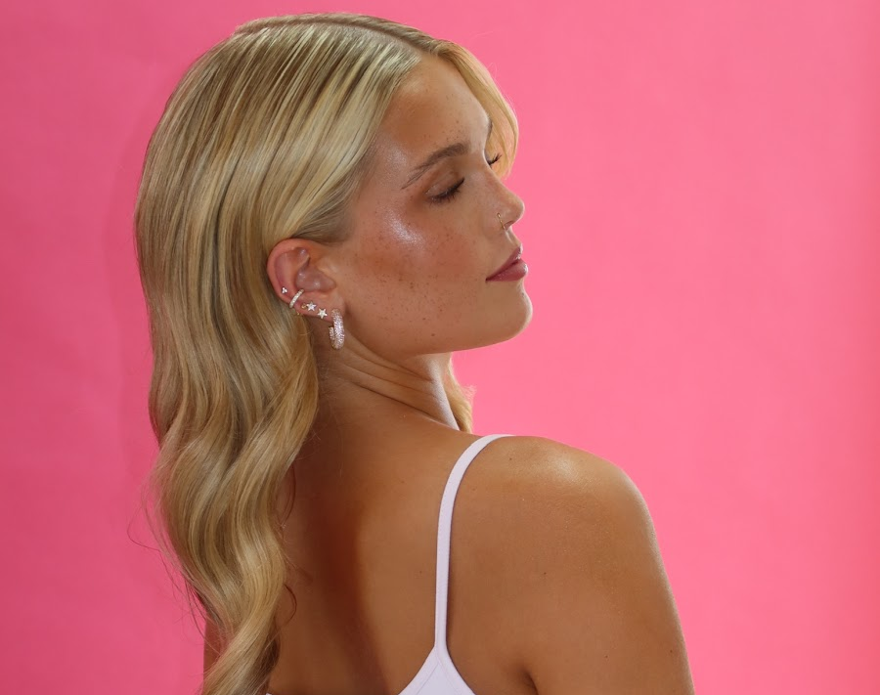

K❤︎‬ETE Campaign Proposal
Presented to you by: Ava Marini, Cortney Smith, Flavia Yaffe, Katherine Adams, & Taisiya Ivanchikova

Slide 2


Slide 3
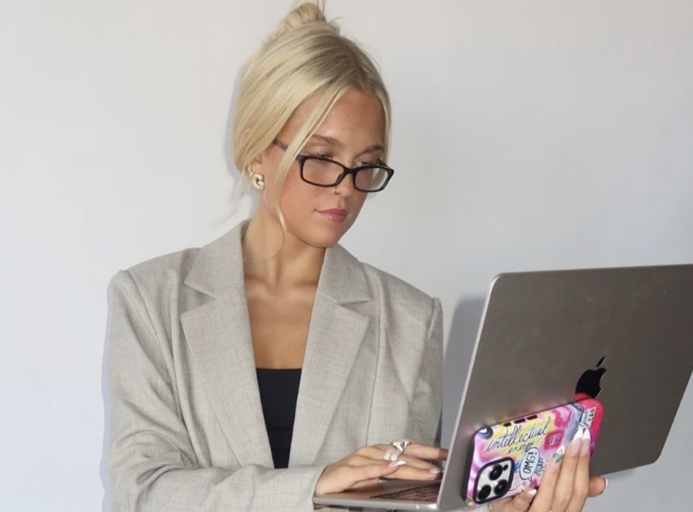
What is KAETE?
KAETE is a female-founded lifestyle apparel brand inspired by founder Gertie Nazaroff. Kaete, Gerties mother, serves as the brand’s original muse. The brand was created to celebrate the meaningful connections between mothers and daughters while recognizing that every family story is unique.

Slide 4
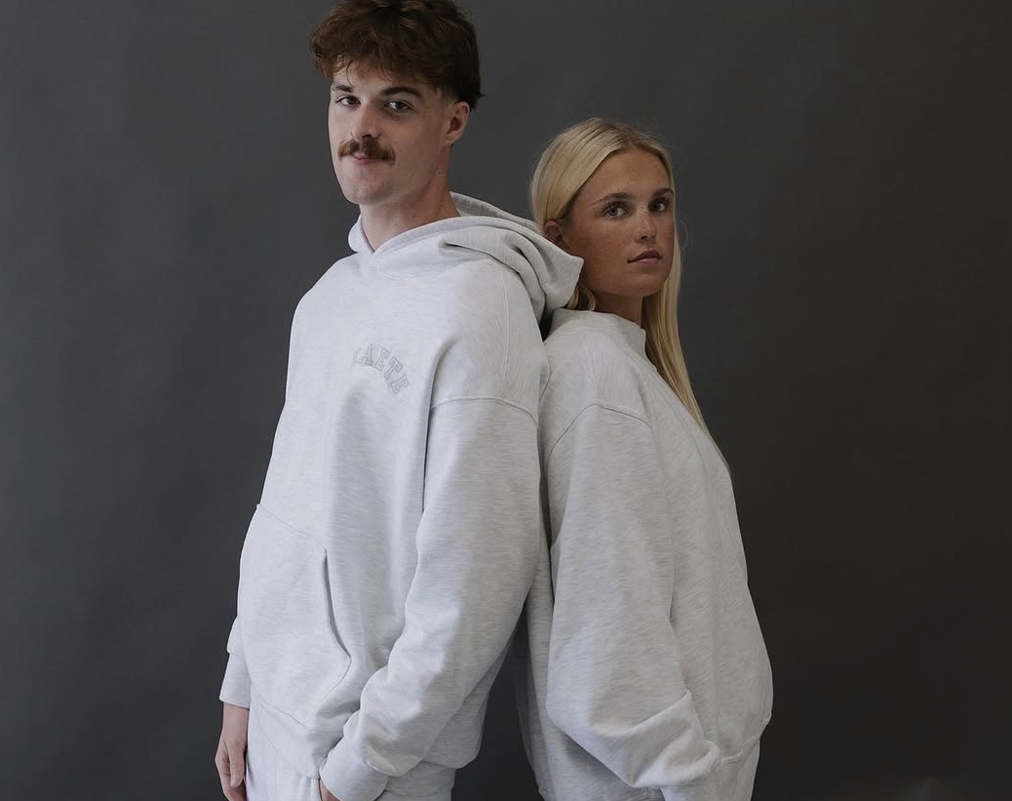
what Is the focus of Kaete?
KAETE's focus goes beyond clothing. The brand promotes equality, diversity, and inclusion by creating a space where everyone feels seen, valued, and represented. It embraces women’s voices, size inclusivity, cultural diversity, and the freedom for people to express themselves authentically.
Through comfortable, timeless apparel and purpose-driven messaging, KAETE aims to build a community rooted in love, connection, and self-expression. The brand's mission is not only to create fashion, but also to foster a welcoming environment where people can celebrate their individuality and feel a sense of belonging.

Slide 5


Campaign Overview
This campaign with the University of Florida would be a 10-week campaign where the brand would be able to sell limited edition sweatshirts with UF embroidery on campus in front of the Reitz Student Union throughout the week during the day. Students would be able to shop all things clothing and accessories while learn more about the brand and its relatability with college students in lifestyle and fashion.
The idea of this campaign is to increase visibility and consumer awareness with the brand, we purpose that our client establish themselves on college campuses to better attract their target audience. Pop-ups on college campuses has increased in popularity and has shown a significant increase in brand awareness. According to

Slide 6
Campaign SMART GOALS
Increase awareness, engagement, online-store traffic among University of Florida students by leveraging on-campus pop-ups and online discounts for college students to position KAETE as a trusted lifestyle apparel bran

Slide 7
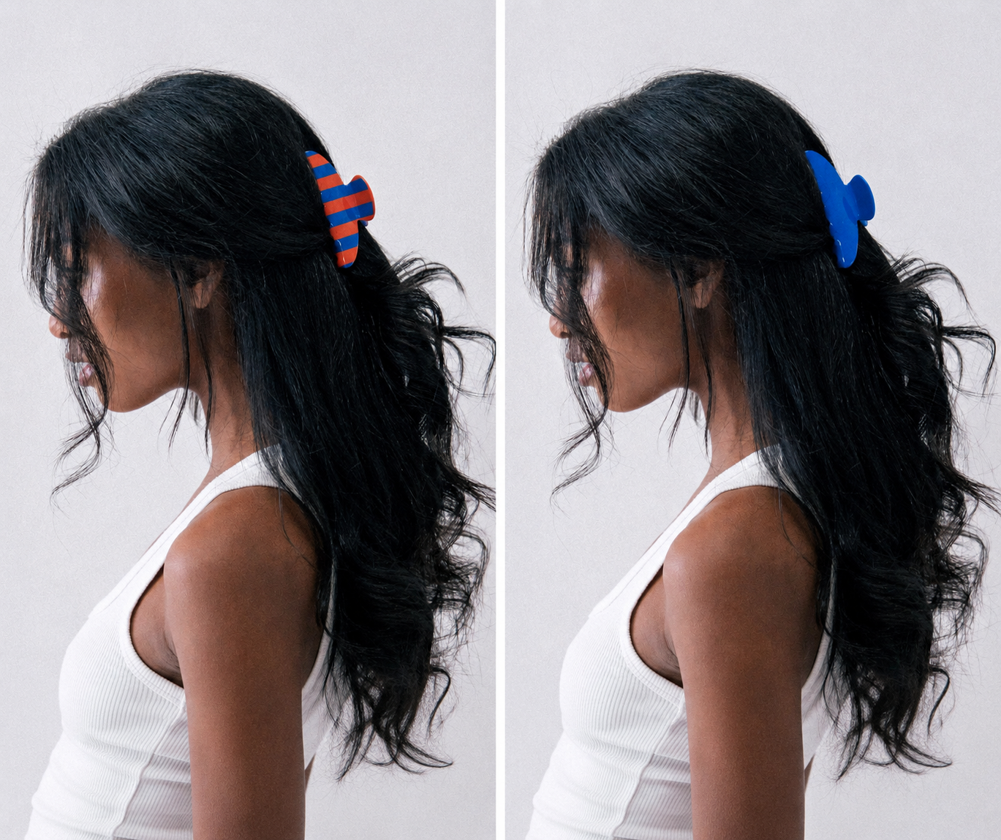
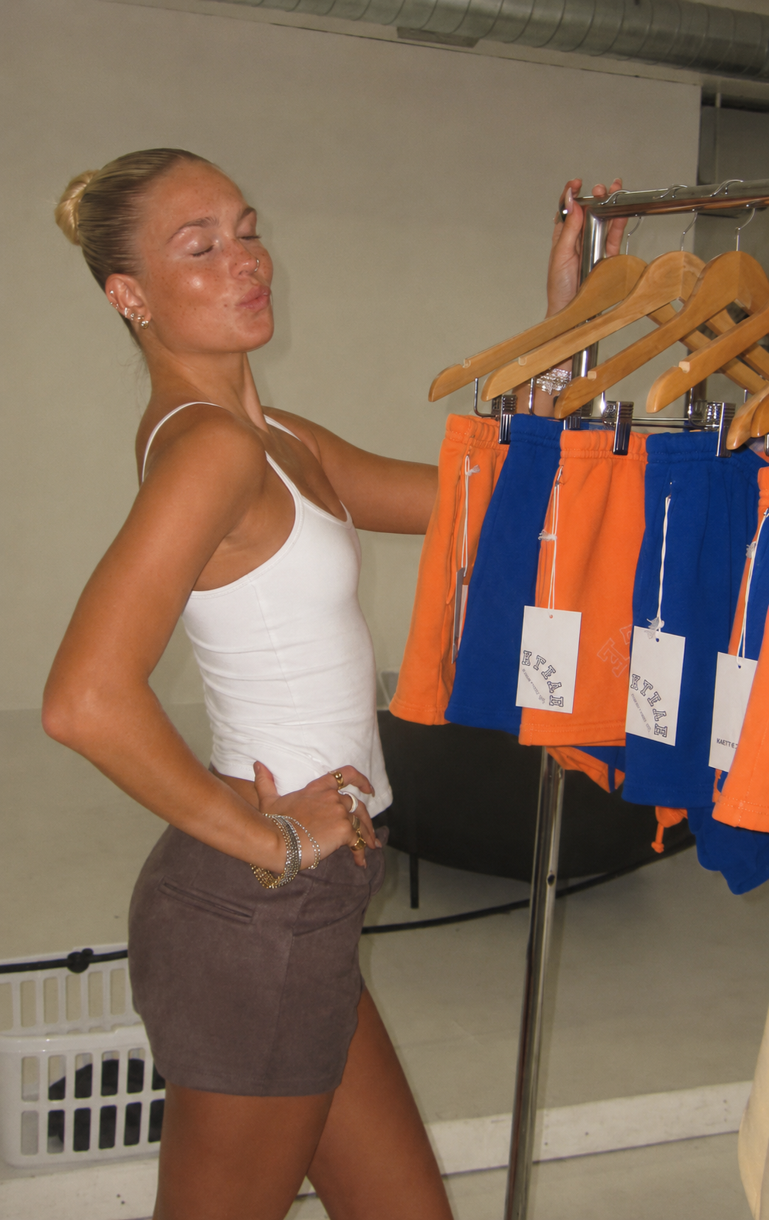
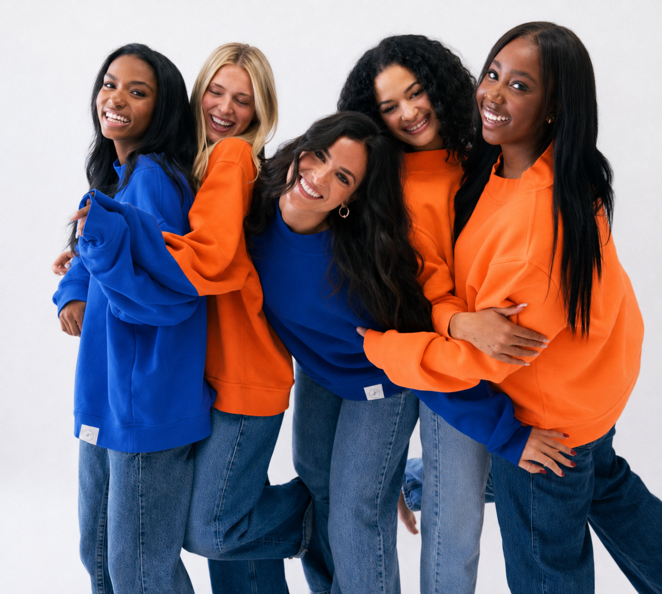
overview of included items

Slide 8
Audience Description + Demographics- Katherine
Campaign evaluation:
Audience description + demographics
Audience research support & data

Slide 9
Influencer recommendation + What the influencer will do and tie the influencer back to the target audience

Slide 10
Week one content calendar
Week 1
Date | Time (EST)
Mon, Jan 11 | 5:00 p.m.
Wed, Jan 13 | 7:00 p.m.
Fri, Jan 15 | 6:30 p.m.

Slide 11
Week Two content calendar
Week 2
Date | Time (EST)

Slide 12
Week Three content calendar
Week 3
Date | Time (EST)

Slide 13
Week one content calendar
Week 4
Date | Time (EST)

Slide 14
Flavia
Why Instagram & TikTok
Content types
Mock-ups walkthrough

Slide 15
Flavia Continued

Slide 16
Evaluation Plan (metrics, benchmarks, frequency) Tie back to objectives

Slide 17
Summary

Slide 18
References

